Slide 1

CMSC 137
Data Communications and Networking
Lecture Module
06 - Performance

Slide 2
Module 6: Performance
Rozano S. Maniaol
Lecturer

Slide 3
Transmission Impairment

Slide 4
Transmission Impairment
Signals travel through transmission media which is not perfect
What is sent is not what is received
Attenuation
Distortion
Noise

Slide 5
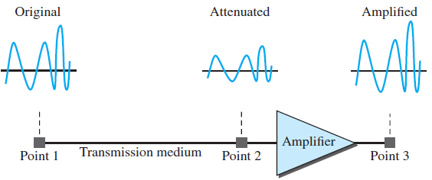
Attenuation
Energy of a signal decreases as it travels through a medium
Amplifiers are used to increase the signal

Slide 6
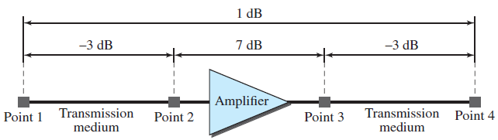
Attenuation
Decibel (dB) – measures the relative strengths of two signals or one signal at two different points

Slide 7
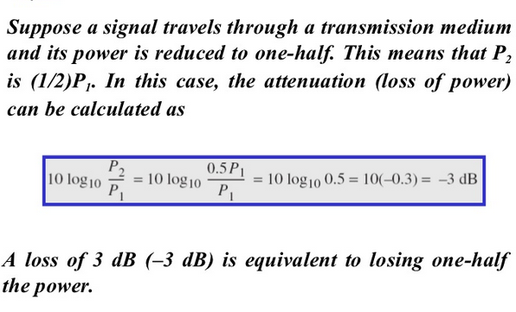
Attenuation

Slide 8
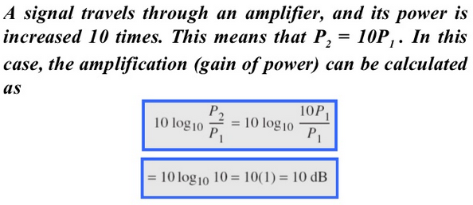
Attenuation

Slide 9
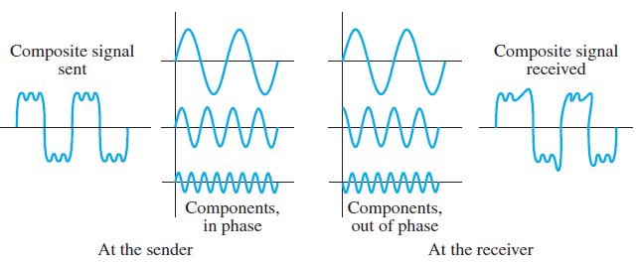
Distortion
Signal changes its form or shape
Each signal component has its own propagation speed, components may be out of phase

Slide 10
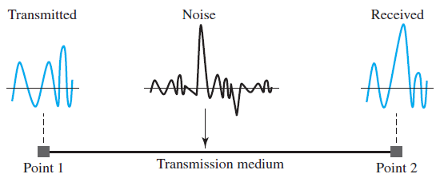
Noise
Types
Thermal – random motion of electrons
Induced – comes from external sources (ex. appliances)
Crosstalk – effect of one wire on the other
Impulse – spike noise (ex. lightning, power lines)

Slide 11
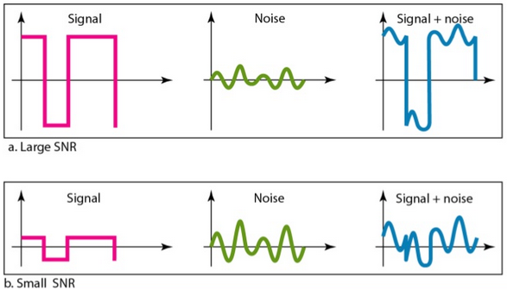
Signal-to-Noise Ratio (SNR)

Slide 12
Data Rate Limits

Slide 13
Data Rate Limits
How fast we can send data, in bits per second, over a channel:
  Bandwidth available
  Level of the signals we use
  Quality of the channel (level of noise)
Theoretical Formula:
  Nyquist Bit Rate (Noiseless channel)
  Shannon Capacity (Noisy channel)

Slide 14
Data Rate Limits
Nyquist bit rate formula defines the theoretical maximum bit rate (in bps)
The Nyquist formula tells us how many signal levels we need
Increasing the levels of a signal may reduce the reliability of the system

Slide 15
Sample
What is the maximum bit rate of a noiseless channel with a bandwidth of 3 kHz transmitting two signal levels?
How many signal levels are needed to send at 265 kbps over a noiseless channel with a bandwidth of 20 kHz?

Slide 16
Data Rate Limits
Shannon capacity formula defines the theoretical highest data rate for a noisy channel (in bps)
The formula defines a characteristic of the channel, not the method of transmission
The Shannon capacity gives us the upper limit

Slide 17
Sample
A telephone line has a typical bandwidth of 3000 Hz (300 to 3300 Hz) for data communications. SNR is 3162. What is the capacity?

Slide 18
Using both limits
In practice, both methods are used to find the limits and signal levels
Example:
We have a channel with 1-MHz bandwidth. The SNR for this channel is 63. What are the appropriate bit rate and signal level?
Use Shannon formula to find the upper limit

Slide 19
Using both limits
The Shannon formula gives us 6 Mbps, the upper limit. For better performance, we choose something lower.
Let’s say we use 4 Mbps. We use the Nyquist formula to find the number of signal levels

Slide 20
Performance

Slide 21
Performance
Bandwidth
  Range of frequencies a channel can pass (Hz)
  Number of bits per second that a channel can transmit (bps)
  An increase in bandwidth in hertz means an increase in bandwidth in bits per second
Throughput – how fast we can actually send data through a network
Latency (Delay) – how long it takes for an entire message to completely arrive at the destination from the first bit

Slide 22
Performance
Propagation Time – time required for a bit to travel from source to the destination
Transmission Time – time to transmit all the bits
Queuing Time – time to hold the message before it is processed

Slide 23
Performance
What are the propagation time and the transmission time for a 2.5 kB email if the bandwidth is 1 Gbps? Assume the distance between the sender and the receiver is 12,000 km and light travels at 2.4 x 10⁸ m/s

Slide 24

Bandwidth-Delay Product
Defines the number of bits that can fill the link

Slide 25

Bandwidth-Delay Product
Bandwidth: 1 bps Delay: 5 s
Bandwidth x Delay = 5 bits
After 1 s
1st bit
After 2 s
1st bit
After 3 s
1st bit
After 4 s
1st bit
After 5 s
1st bit
1 s
1 s
1 s
1 s
1 s

Slide 26
Bandwidth-Delay Product
Bandwidth: 5 bps Delay: 5 s
Bandwidth x Delay = 25 bits
After 1 s
1st 5 bits
After 2 s
1st 5 bits
After 3 s
1st 5 bits
After 4 s
1st 5 bits
After 5 s
1st 5 bits
1 s
1 s
1 s
1 s
1 s

Slide 27
Performance
Jitter
  If different packets of data encounter different delays and the application using the data at the receiver is time-sensitive

Slide 28
References
Forouzan, B.A. 2013. Data Communications and Networking, 5th Ed. McGraw-Hill, New York.

